Slide 1


Academic Risk Predictor
Proposal
Random Forest Model
-Sudin Maharjan [250407]

Slide 2
Problem Statement!
Late identification of at-risk students
Only GPA & Attendance used
No early warning system

Slide 3
Objective
Predict risk early
Use multi-factor features
[mobile phone usage patterns, sleep duration, stress levels, and chronic illness status
integration of health and behavioural indicators alongside traditional attendance and
socio-economic data]
Enable targeted intervention
[A student with high mobile usage + low sleep → Provide counseling + time management guidance
A student with low family income + poor study environment → Provide financial aid or resources]

Slide 4

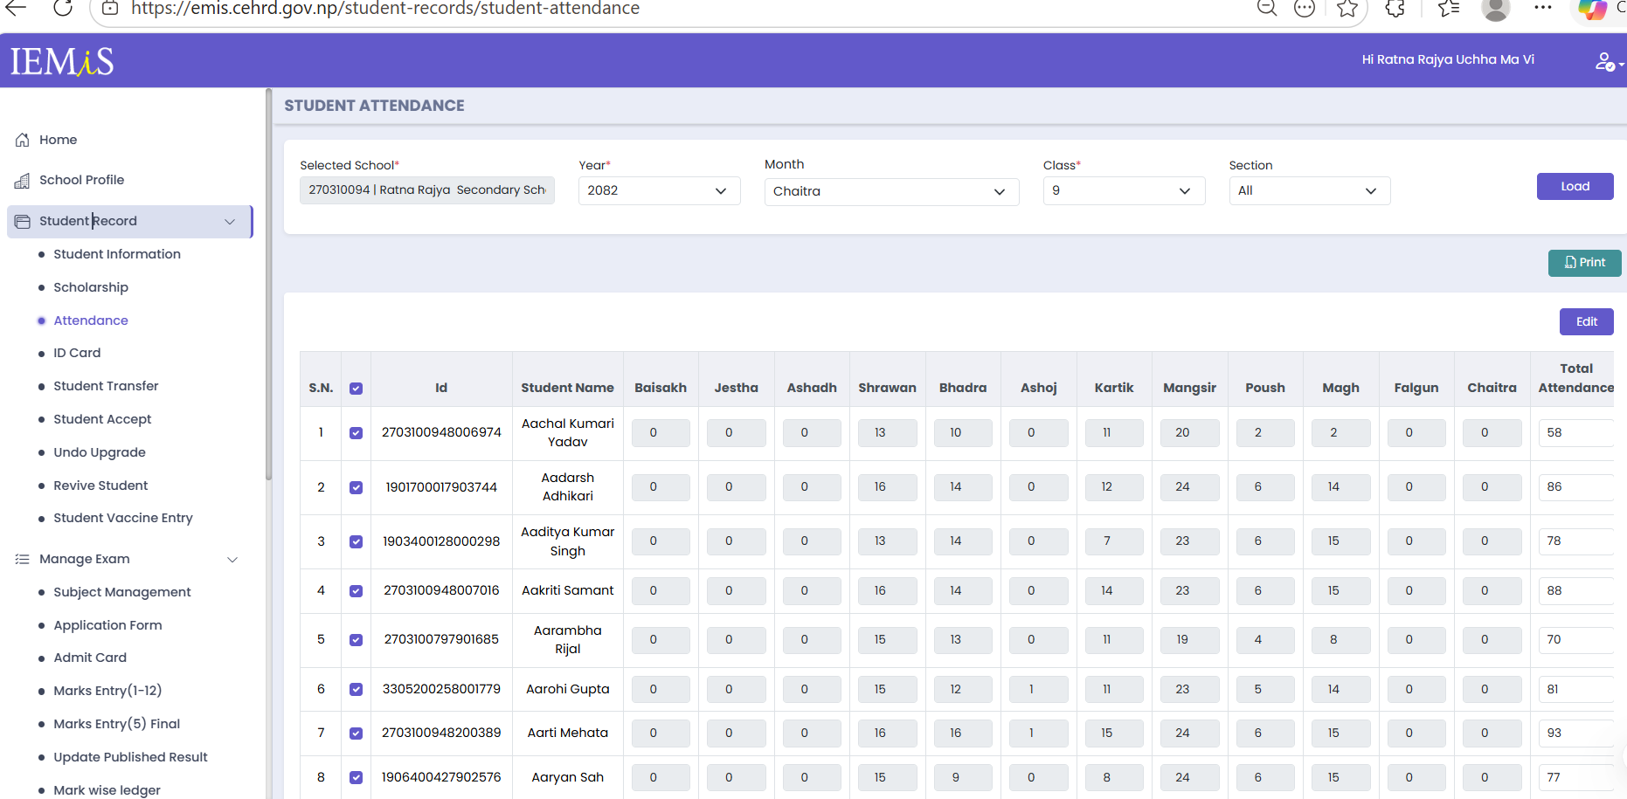
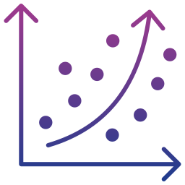
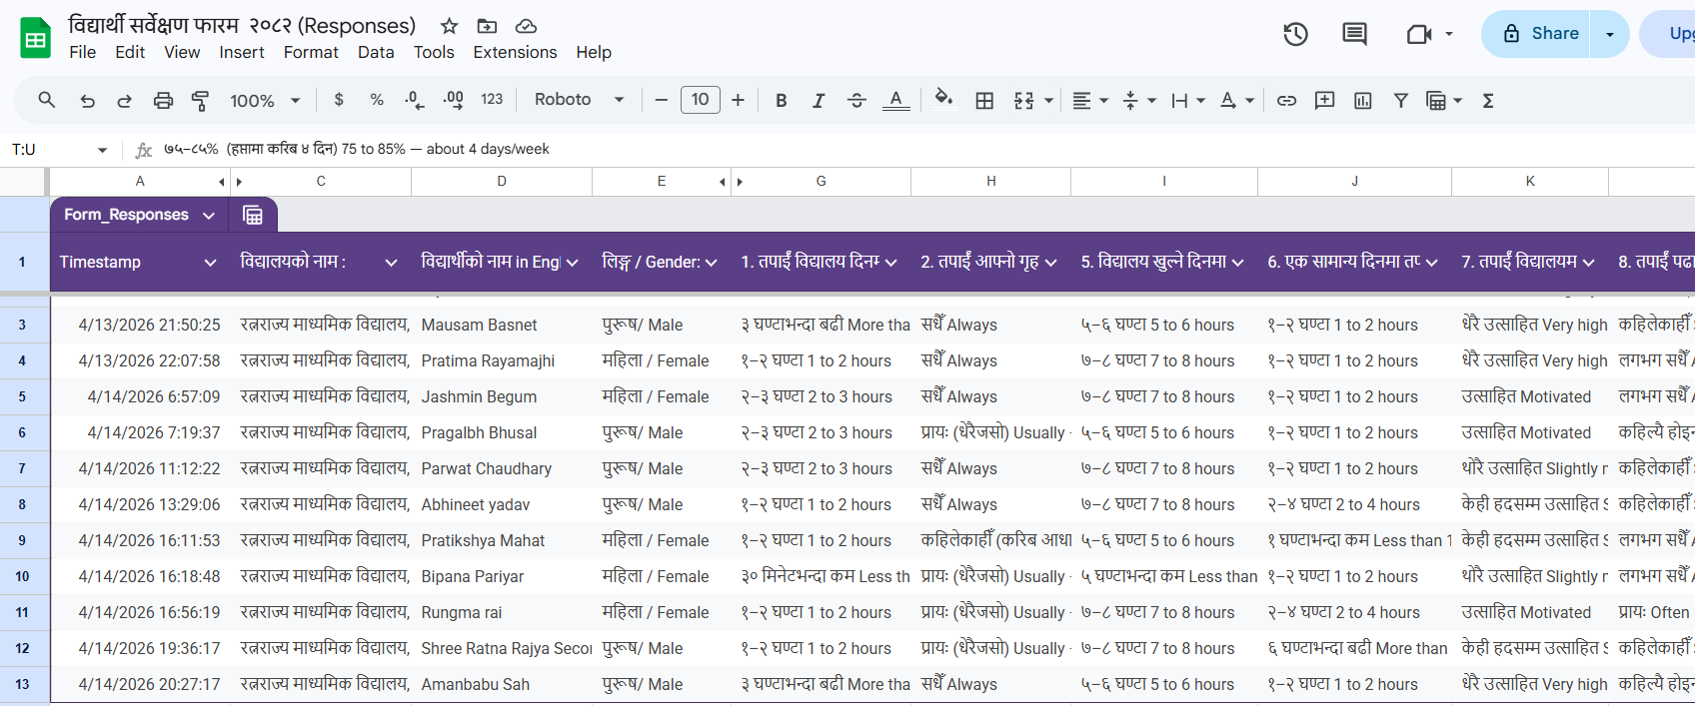
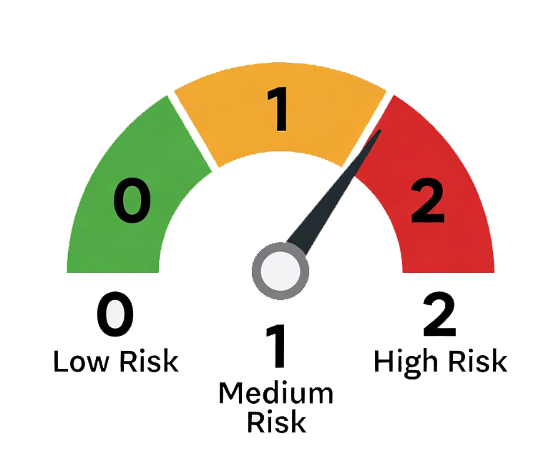
Proposed Approach
Random Forest model
Handles non-linear relationships,
Works well with mixed features,
Reduces overfitting,
Provides feature importance
EMIS + Questionnaire data
Real data: academic performance+
behavioral/social context
Output:
Risk level Prediction- high/medium/low
Feature importance-identifies the key factors behind academic risk

Slide 5
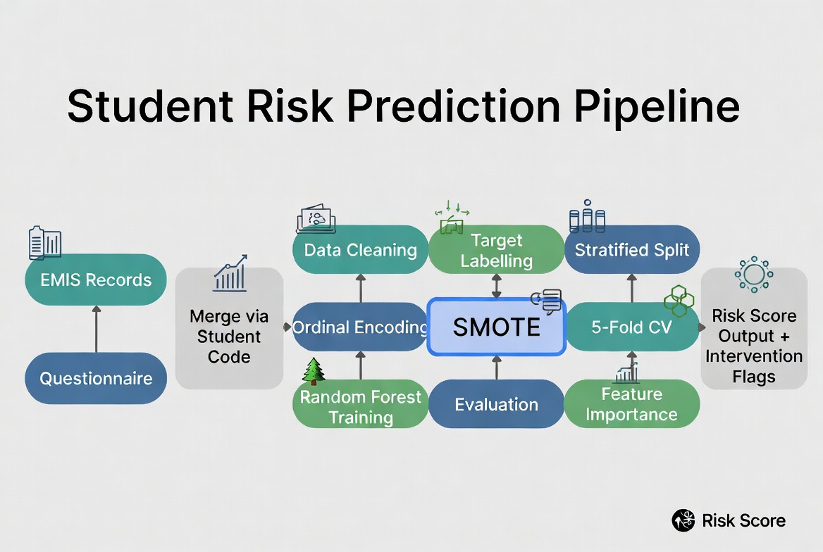
Methodology
Data Collection & Integration
Data Preprocessing-imputation & numerically encoded
Data Splitting-training (80%) & testing (20%)
Class Imbalance Handling-SMOTE (k=5 nearest neighbors)
Train Random Forest classifier - hyperparameters optimization using Grid Search with 5-fold cross-validation.
Evaluation & Output Generation-accuracy, precision, recall, F1-score, and confusion matrix/outputs risk level prediction

Slide 6
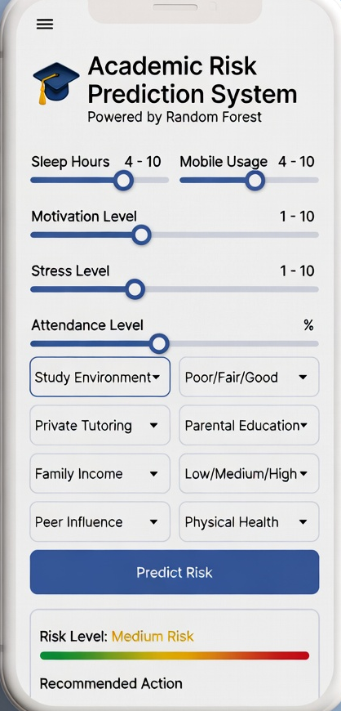
Conclusion
Expected Performance
80-90%
High-Risk Recall:≥ 0.80
Accuracy
Early detection (8–10 months earlier)
Better intervention planning
Supports teachers & policymakers

Slide 7
Thanks

